Slide 1


Working with database models and relations

Slide 2
Running and connecting to databases
The taskMainList query
Error reporting
Resolving relations
Table of Contents
Notes:
This lesson covers
Creating object types for database models
Defining a global context shared among all resolvers
Resolving fields from database models and transforming their names and values
Resolving one-to-one and one-to-many relations
Working with database views and join statements
Now that you’ve learned the core concepts of building a simple “static” schema and how to resolve its fields, it’s time to get real and learn how to resolve fields from databases. It’s time to implement the queries of the AZdev API. We’ll go through them one by one as we designed them in lesson 4 and learn the concepts we need as we use them.

Slide 3

Running and connecting to databases
Once Docker is running, you can run this command to start both databases.
$ npm run start-dbs
Notes:
The easiest way to get this project’s databases up and running with sample data is to use Docker. Docker uses your OS virtualization to provide software in packaged containers. It’s available on all three major operating systems.
I’ve prepared two Docker containers for this project: one for PostgreSQL and one for MongoDB. They both have the database structure created and the sample data imported. If you’re new to Docker, no worries. It’s really simple. All you need is to install Docker Desktop (az.dev/docker) on your OS and leave it running in the background.
NOTE
If you would like to use your own database services for the project, you can execute the dev-dbs/schema.* files to create the database entities and load the sample data.
This command will take a while the first time you run it as it will download the two containers on your machine. It will also start these containers and expose the database on their default ports. PostgreSQL will be running on port 5432 and MongoDB will be running on port 27017.
NOTE
I’ve also provided a Docker file to download and run clean blank databases if you would like to go through the steps to create a database schema and load it up with sample data.
Having sample data in all tables and collections is a great way to get started and enable us to test the GraphQL queries before dealing with the GraphQL mutations! Make sure you get some realistic data in all the database tables one way or another.
Take a look at the dev-dbs/schema.* files, and verify the structure of tables and collections that we designed in lesson 4. Note the insert statement I prepared there for the sample data.
TIP
The dev-dbs/schema.sql file uses the pgcrypto extension to manage the hashing of passwords and tokens in the users table. You can read the documentation for this extension at az.dev/pgcrypto.

Slide 4
Running and connecting to databases
If the database servers run successfully, you should have six Tasks with their Approaches and some extra dynamic data elements in MongoDB for each Approach.
Use the following SQL queries to see the data in PostgreSQL.
SELECT * FROM azdev.users;
SELECT * FROM azdev.tasks;
SELECT * FROM azdev.approaches;

Slide 5
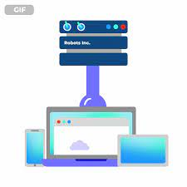
Running and connecting to databases
For the data in MongoDB, you can use this find command.
db.approachDetails.find({});
Notes:
TIP
You can use database GUIs to inspect the databases and make sure they have the sample data loaded up. On my Mac, I use Postico for PostgreSQL (az.dev/postico) and Robo 3T for MongoDB (az.dev/robo).
Before a client can execute commands on a database and retrieve data from it, it needs to connect to it. There are many ways to connect to both PostgreSQL and MongoDB from the Node drivers.

Slide 6
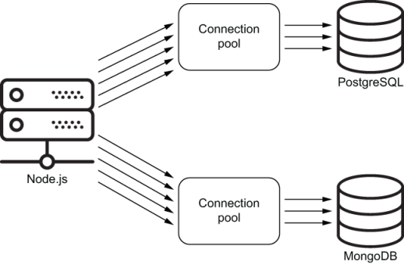
Running and connecting to databases
Notes:
We can do a one-time connection per SQL statement in the pg driver, but a better way is to have the driver manage a pool of open connections and reuse them as needed (figure). Both drivers support this mode.
The code to connect to these databases is ready under api/src/db/. Take a look at pg-client.js and mongo-client.js and see if you need to do anything differently. If your local copy of the project fails to connect to databases, these two files are where you need to start troubleshooting.
Note that I tested the connections to both databases by counting the numbers of tables/collections. This step is optional, but it verifies that connections are successful when the server starts.
TIP
Note that I made both database client modules (under api/src/db) return an object with similar purposes. I find that kind of normalization helpful for entities in the project that are meant to do similar things.

Slide 7
Running and connecting to databases
The taskMainList query
Error reporting
Resolving relations
Table of Contents

Slide 8
Let’s start by implementing the main Task type.
Here is the SDL text we prepared for it.
type Task implements SearchResultItem {
id: ID!
createdAt: String!
content: String!
tags: [String!]!
approachCount: Int!
# author: User!
# approachList: [Approach!]!
}
The taskMainList query
Notes:
To be able to work with Task records in the GraphQL schema, we need to define a new custom type for these records just like what we did for numbersInRange when we converted it from a leaf field into a non-leaf field. We need to create a custom type for each entity in the AZdev API: a Task type, an Approach type, and a User type.

Slide 9
The taskMainList query
The first query field that will use this Task type is the list of the latest Tasks that will be displayed on the main page of the AZdev app.
We named that field taskMainList.
type Query {
taskMainList: [Task!]
}
Notes:
To learn the concepts in the right order, let’s start with the five simple scalar leaf fields under this type: id, content, tags, approachCount, and createdAt.

Slide 10
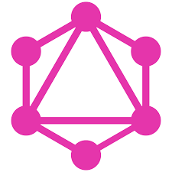
The taskMainList query
A GraphQL query that we can use to start testing this feature.
query {
taskMainList {
id
content
tags
approachCount
createdAt
}
}

Slide 11
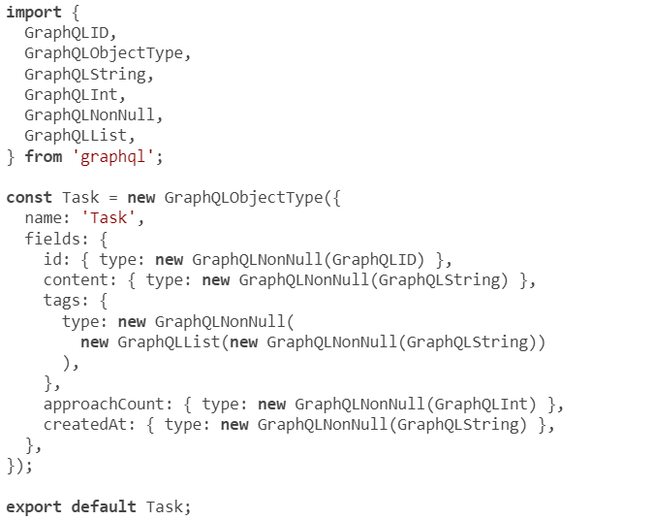
Defining object types
Notes:
Here’s a possible implementation of the new Task type (without any resolvers). Put this under api/src/schema/types/task.js.
The Task object here is just a direct translation of the SDL text in listing 6.4. The six lines in the SDL version more than tripled with all the object-based method boilerplate code. The worst part about this is probably the type for the tags field.

Slide 12

Defining object types
The simple [String!]! had to be written with nested calls of three functions:
new GraphQLNonNull(
new GraphQLList(
new GraphQLNonNull(
GraphQLString
)
)
)
Notes:
There is no debate that the SDL text is a better way to present this type. This is why many tools were created to enable building GraphQL schemas based on SDL texts for types and other elements. The GraphQL.js buildSchema function itself was popularized by these tools. Some tools expanded the SDL syntax to enable modularizing an SDL-based schema into many parts. Other tools were introduced to merge multiple SDL-based schemas and resolve any conflicts between them. These tools are helpful and have practical uses, but I would like to keep this course focused purely on the GraphQL.js implementation and use the natively supported object-based method.
USING SDL WITH THE OBJECT-BASED METHOD
In the future, the GraphQL.js implementation might support an API that will allow you to use an SDL text with the object-based method (so it’s not one way or the other).

Slide 13
The context object
We need to execute this SQL statement on the PostgreSQL database to resolve field.
SELECT *
FROM azdev.tasks
WHERE is_private = FALSE
ORDER BY created_at DESC
LIMIT 100
Notes:
The next step is to modify the Query type to include the taskMainList field. This field is a list of non-null items where each item has the Task type introduced in listing 6.4. This means the type for the taskMainList field should be new GraphQLList(new GraphQLNonNull(Task)).
Before we can execute this SQL query, we need to open the pool of connections to PostgreSQL. To do that, we need to import the api/src/db/pg-client.js module and invoke its default export (the pgClient function). But where exactly should we do this?
The pool of connections to a database should be started when the server is started and then made available to all the resolver functions that are going to use it. This is a lot more efficient than connecting to the database from within resolver functions.
The GraphQL.js implementation has a feature to help us make a pool of connections globally available to all resolvers. It’s called the context object.
The special context object enables resolver functions to communicate and share information because it is passed to all of them (as their third argument). They can read it and write to it if needed. We only need a readable context for sharing the pool of database connections.
You can pass any object as the context object to the graphql executor function or the graphqlHTTP listener function. The object that we need to make part of the global context here is the pgPool object that is returned by the pgClient function.

Slide 14
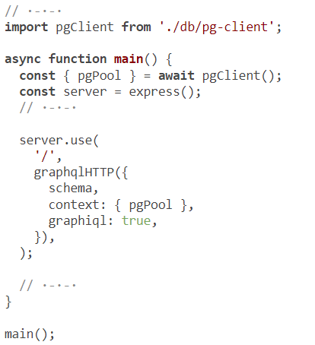
The context object
Notes:
Here are the changes we need in api/src/server.js to make the pgPool object available using the GraphQL context concept.
Now all resolver functions will have access to the context object, and we can use the pgPool object to execute database queries in them!

Slide 15

The context object
The pgPool object has a query method we can use to execute a SQL statement.
const pgResp = await pgPool.query(`
SELECT *
FROM azdev.tasks
WHERE is_private = FALSE
ORDER BY created_at DESC
LIMIT 100
`);
Notes:
We can use it this way to execute the SELECT statement in listing 6.8
The result of the query method is a promise that will resolve to an object, which I named pgResp.

Slide 16
The context object
The pgResp object will have a rows property holding an array of objects representing the rows returned by the database.
[
{ id: 1, content: 'Task #1', approach_count: 1, ·-·-·},
{ id: 2, content: 'Task #2', approach_count: 1, ·-·-·},
·-·-·
]
Notes:
Note that the pg package transforms every database row into a JavaScript object with the database field names as keys and the row values as the values for these keys. Also note that the key names use the snake-case format (for example, approach_count).

Slide 17
The context object
The context object is exposed to each resolver function as the third argument (after source and args).
resolve: (source, args, context, info) => {}
Notes:
NOTE
The fourth info argument will have information about the execution context, like what field/type this resolver is associated with. This argument is rarely used but is handy in a few advanced cases.

Slide 18
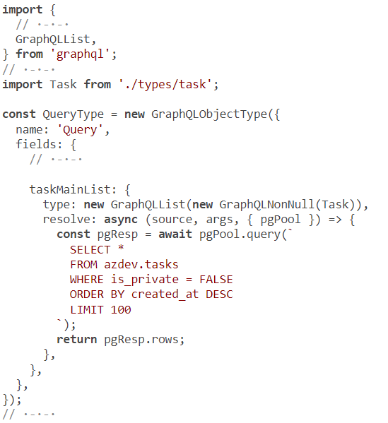
The context object
Notes:
The taskMainList field should be resolved with an array of Task records (and the rows property on the pgPool.query response in listing 6.10 is that exact array). Remember from the previous lesson that you can return a promise from a resolver function, and GraphQL.js will do the right thing for it.
We can just resolve taskMainList with the promise returned by the pgPool.query function.

Slide 19
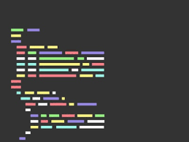
The context object
Lets test things now. The API should be able to answer this query (see next slide):
{
taskMainList {
id
content
}
}

Slide 20
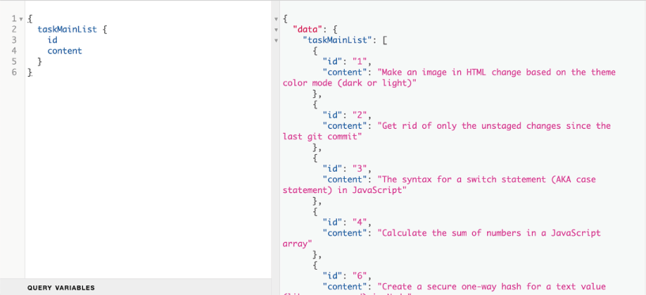
The context object
Notes:
If you try to ask for the tags or createdAt field, you’ll get the following errors:
For the tags field, you’ll get this error message: “ Expected Iterable, but did not find one for field Task.tags.”
For the createdAt field, you’ll get this error message: “ Cannot return null for non-null field Task.createdAt.” The same error will occur for the approachCount field.
Take a moment and try to figure out these error messages. I’ll explain them in the next section.
USING A SUBSET OF FIELDS IN SQL
Since we did a SELECT * operation, all fields available in the azdev.tasks table will be available on the parent source object in the Task type. However, only the properties represented by the defined fields will be available in the API. You can optimize the SQL statement to only include the fields that the API is interested in.

Slide 21
Transforming field names
In some cases, we need the API to represent columns and rows in the database with a different structure.
Maybe the database has a confusing column name; or maybe we want the API to consistently use camel-case for all field names, and the database uses snake-case for its columns.
Notes:
This latter situation is exactly what we have to deal with next. Columns on the azdev.tasks table are snake-case in the database (for example, created_at), and we planned to represent all fields as camel-case in the API (createdAt). This means we cannot rely on the default resolvers as we did for the id and content fields.
With camel-case fields, the default resolver tries to find the property createdAt on the row returned by the database. That property does not exist. That’s why we got an error when we tried to ask for createdAt.
There are three main methods to deal with this issue.

Slide 22

Method #1
resolve: async (source, args, { pgPool }) => {
const pgResp = await pgPool.query(
// ·-·-·
);
return pgResp.rows.map(caseMapper);
},
Notes:
We can simply perform a case map on all properties on each row when we get data back from the database. This way, the parent source object for the Task type will have the right property names, and all fields can be kept using the default resolvers. For example, if we have a function caseMapper that takes an object and makes all of its properties camel-case, we can modify the resolver of taskMainList as follows.
TIP
The caseMapper function implementation is omitted here, but you can use a function like camelizeKeys from the humps Node package. That function even supports converting an array of objects, and it will camel-case all properties on all objects in that array.
Can you spot a problem with this method? Actually, can you spot two problems with it? Not only are we looping over each row in the returned set (with the map method), but the caseMapper function loops over all the properties of a row object.
This is probably not a big deal if you’re working with small sets of data. However, the GraphQL tree/resolver structure is already looping over fields and levels. We can use a field resolver to do the conversion manually when needed. That’s method #2.

Slide 23
Method #2
const Task = new GraphQLObjectType({
name: 'Task',
fields: {
// ·-·-·
createdAt: {
type: new GraphQLNonNull(GraphQLString),
resolve: (source) => source.created_at,
},
},
});
Notes:
We can create custom resolvers for the fields that need to be converted. For example, we can change the createdAt field in listing 6.7 to include this resolve function.
This takes care of the case issue because we are resolving a createdAt field using the created_at property available on the parent source object (which is the row object coming from the database). You’ll need to do this for each multiword field.

Slide 24
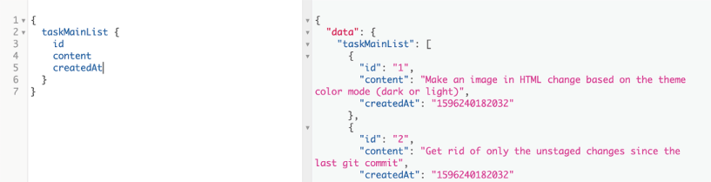
Method #2
Notes:
If you made this change, you can test the API by asking for a createdAt field on the taskMainList field, it will work
NOTE
The createdAt reply is a 13-digit number. This is the number of milliseconds since midnight 01 January 1970 UTC. We’ll change that value in the next section.
I like the readability of this method, and it’s also helpful when you need to perform other custom logic on the value, not just map it as is. However, I am not a fan of mixing snake-case variable names with camel-case. It would be ideal if API server logic did not have to deal with snake-case variables. PostgreSQL has something up its sleeve to save us from needing to do the transformation in the first place! That’s method #3.
NOTE
Before you proceed, undo the resolve function changes in listing 6.15 (if you made them).

Slide 25

Method #3
resolve: async (source, args, { pgPool }) => {
const pgResp = await pgPool.query(`
SELECT id, content, tags,
approach_count AS "approachCount", created_at AS "createdAt"
FROM azdev.tasks
WHERE // ·-·-·
`);
return pgResp.rows;
},
Notes:
We can use the column alias feature in PostgreSQL to make it return the rows natively as camel-case. However, this solution requires listing all the leaf fields in the SELECT statement. For example, here’s a version of the taskMainList resolver function to implement this method.
Note that I use the AS "approachCount" and AS "createdAt" syntax to rename the returned columns. The quotes around the aliases are required because PostgreSQL is case insensitive. To force it to behave otherwise, you need to use quotes.
I think this is the better method because it makes the data come from PostgreSQL in the exact shape we need and because, in my opinion, having to list the column names that a statement needs is a good thing. Specificity is always the safer way.
NOTE
You will not need to write any SQL statements or aliases beyond this first example. All SQL statements with their aliased column names are available in api/src/db/sqls.js.

Slide 26
Transforming field values
We can use the JavaScript toISOString method for this.
We’ll need to implement the createdAt field’s resolver function using the following.
createdAt: {
type: new GraphQLNonNull(GraphQLString),
resolve: (source) => source.createdAt.toISOString(),
},
Notes:
GraphQL’s default serialization for date objects in JavaScript is to call the valueOf method on them, and that method is equivalent to calling getTime (which returns the 13-digit milliseconds number). If we want to serialize fields (including date fields) differently, we can do that in custom resolver functions. For example, let’s serialize all date-time fields for the AZdev API using UTC ISO format.
NOTE
Note that I used source.createdAt (and not source.created_at) since PostgreSQL returns data in camel-case object properties now.

Slide 27
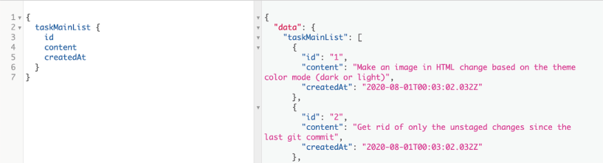
Transforming field values
Now the API displays values of createdAt using the ISO format
Notes:
What about the tags field? Currently, the API is displaying this error for it: “Expected Iterable, but did not find one for field Task.tags.”
This is because we defined the tags field as a GraphQLList type. The GraphQL executer expects its resolved value to be an iterable, like an array.

Slide 28
Transforming field values
tags: {
type: new GraphQLNonNull(
new GraphQLList(new GraphQLNonNull(GraphQLString))
),
resolve: (source) => source.tags.split(','),
},
Notes:
The default resolver for the tags field is currently resolving with what’s in the tags database column: a string of comma-separated values (for example, "node,git"). We need to transform this value into an array of strings instead (so, ["node", "git"]). We do that with a custom resolver function.

Slide 29
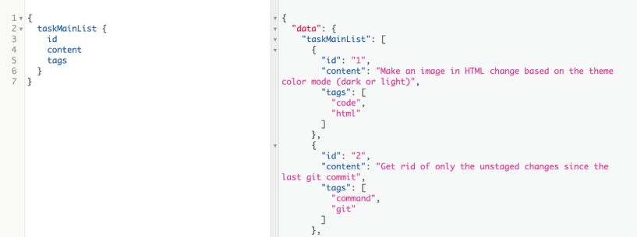
Transforming field values
Notes:
the resolver will return an array when asked for the tags property
As you can see, it is fairly easy to control the shape of the GraphQL schema and use powerful transformation on the raw data returned by the database.

Slide 30

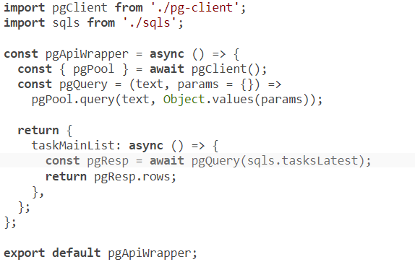
Separating interactions with PostgreSQL
Notes:
Before we continue implementing the author/approach relations on the Task type, let’s do a small refactoring. Instead of using SQL statements directly in resolver functions, let’s introduce a module responsible for communicating with PostgreSQL and just use that module’s API in the resolver functions.
This separation of responsibilities will generally improve the readability of the API’s code. The logic to fetch things from PostgreSQL will not be mixed with the logic to transform raw data into the public API. This new module will also improve the maintainability of the code! If the database driver changes its API or if a decision is made to use a different database driver, you can make these changes in one place instead of many. You’ll also have one place where you can add logging or any other diagnostics around database calls. It will also be a lot easier to test this new module on its own, isolated from the other logic in the resolver functions, and to test the logic in the resolvers by mocking this new module.
I’ll name this new module pgApi. We’ll expose it in the context object instead of the driver’s native pgPool object and make all read and write interactions with PostgreSQL through it.
Let’s also move the line in api/src/server.js where we called the pgClient function to get a pgPool into this new pgApi module. This is an asynchronous operation, which means we need the pgApi module to be wrapped in an async function. I’ll name this function pgApiWrapper and make it the default export in the new module.
Here’s the implementation I came up with. Put this in api/src/db/pg-api.js.
Note that I imported the sqls object from the provided ./sqls.js file and used sqls .tasksLatest. That is the same SQL query as in listing 6.16. Having all the SQL statements in one place is a simple way to organize this module. Another way would be to create a file per database API function and have that file define the SQL statements it needs. The latter is better for bigger projects, but I’ll leave the simple two-file structure here. The pg-api.js file will define the functions, and the sqls.js file will define the SQL statements.
Also note that I introduced a new function, pgQuery, which is a wrapper for pgPool.query. The pgPool.query function is the current driver’s method, and it expects query variables as an array. The pgQuery function is something we can control any time when needed, and I made it receive query variables as an object (which will make the code a bit more readable, in my opinion).
TIP
Wrapping third-party APIs is generally a good practice, but don’t overdo it! For example, I have not wrapped the GraphQL.js API yet because the project’s entire structure depends on it. The AZdev API code is not just using GraphQL.js; it’s built around it. When GraphQL.js makes a non-backward-compatible change to its API, it will probably be time for a complete project overhaul. However, the other benefits to wrapping a third-party API still apply. For example, if we would like to change the syntax of creating type objects to reduce the boilerplate and use something similar to the SDL method, we can introduce a wrapper.

Slide 31
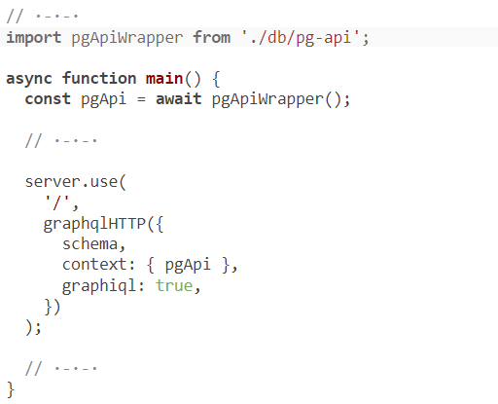
Separating interactions with PostgreSQL
Notes:
Now we need to change the context object in api/src/server.js to use the new pgApiWrapper function instead of the driver-native pgClient function.

Slide 32
Separating interactions with PostgreSQL
Finally, we need to change the resolve function for taskMainList to use the new pgApi instead of issuing a direct SQL statement.
taskMainList: {
type: new GraphQLList(new GraphQLNonNull(Task)),
resolve: async (source, args, { pgApi }) => {
return pgApi.taskMainList();
},
},
Notes:
That’s it. You can test all these changes using the same query we’ve been using so far. Nothing changed on the public API service, but a lot has changed in the codebase. The code is off to a better start.

Slide 33
Running and connecting to databases
The taskMainList query
Error reporting
Resolving relations
Table of Contents

Slide 34
Error reporting
const QueryType = new GraphQLObjectType({
name: 'Query',
fields: {
// ·-·-·
taskMainList: {
type: new GraphQLList(new GraphQLNonNull(Task)),
resolve: async (source, args, { pgApi }) => {
return pgApi.taksMainList();
},
},
},
});
Notes:
I would like to introduce one little modification here. By default, the GraphQL.js implementation does not report errors in logs, and that might cause frustration. It will still respond to API consumers with these errors, but as a backend developer, you don’t see them.
Let’s look at an example. Fake an error anywhere in the code that resolves data for the taskMainList field, something like the following.

Slide 35
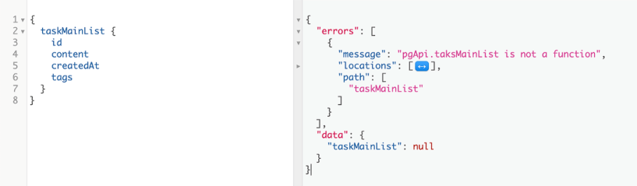
Error reporting
Now observe what happens when you ask for the taskMainList field in GraphiQL
Notes:
You see the error as a consumer (which is bad). You also don’t see the error in the backend at all (which is also bad).

Slide 36
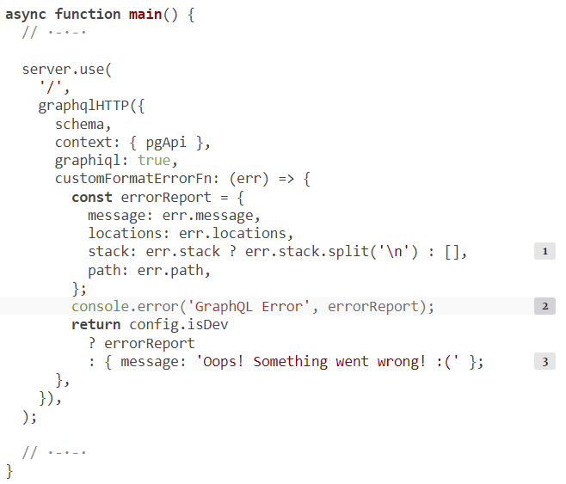
Error reporting
Notes:
To solve that, the express-graphql package supports a customFormatErrorFn option, which is an optional function that can be used to format errors produced while the server is fulfilling GraphQL operations. We can use this function to report the error and return a generic error to the consumer (for example, in production).
With that, if you execute the faulty taskMainList query now, the frontend consumer will see the generic error message while the backend developer will see the helpful error message in the API server logs.
TIP
It’s a common practice to not expose thrown errors to your API consumers in production. These often reveal implementation details and usually are not helpful to users. Only expose helpful error messages to your API consumers. We’ll see examples when we work with mutations.
Don’t forget to undo the intentional typo we made in listing 6.22.
CURRENT CODE
Use git checkout to reset your local repo to the current progress in the code.
It’s now time to talk about resolving relations. This will highlight one of the biggest challenges when creating GraphQL APIs: the infamous N+1 queries problem.

Slide 37
Running and connecting to databases
The taskMainList query
Error reporting
Resolving relations
Table of Contents

Slide 38
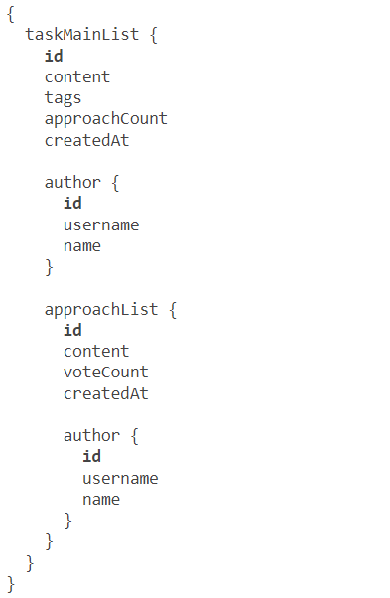
Resolving relations
When we’re done implementing the author and approachList fields, the API server should accept and reply to this query.
Notes:
The remaining fields on the Task type are author and approachList. We’ll need to implement two new GraphQL types for them. I’ll name them Author and Approach.
These fields will not be leaf fields in a query. They represent relations. A Task has one Author and many Approaches. To resolve these fields, the GraphQL server will have to execute SQL statements over many tables and return objects from these tables.
This is the complete query that should be supported by the API service. Note the nested fields Task -> Author and Task -> Approach -> Author.
NOTE
An Approach also has an Author. To complete the taskMainList field, we will have to implement that relation as well.
With this query, we would like to get all the information about all the latest Tasks, who authored them, what approaches are defined on them, and who authored these approaches.
NOTE
The Latest Tasks UI view will not include Approaches. Approaches will be displayed only in the Single Task UI view. For simplicity, I used one Task type here, but type specificity can be used to match expected usage and enforce the acceptable ways to use the API. We’ll see an example under the me root field.

Slide 39
Resolving a one-to-one relation
// $1: userIds
usersFromIds: `
SELECT id, username,
first_name AS "firstName", last_name AS "lastName",
created_at AS "createdAt"
FROM azdev.users
WHERE id = ANY ($1)
`,
Notes:
The author field has to be resolved from the azdev.users table. The foreign key that connects a Task object to a User object is the user_id field on the azdev.tasks table. When we resolved the taskMainList field with a list of Task objects, each of these objects had a value in its userId property. For each one, we have to execute another SQL statement to get information about the User who authored it. You can find that SQL statement under sqls.usersFromIds (in api/src/db/sqls.js).
Note that this SQL statement has a $1 in it. This is new. It’s the syntax we can use with the pg driver to insert a variable into the SQL statement without resorting to string concatenation. The statement is expected to be executed with one variable, and that variable will be used to replace the $1 part.
NOTE
The ANY comparison construct can be used to fetch multiple records from the database using an array of IDs. This is going to help us reduce the number of SQL queries that the API server needs to execute. We’ll see examples in lesson 7.

Slide 40
Resolving a one-to-one relation
const pgApiWrapper = async () => {
// ·-·-·
return {
// ·-·-·
userInfo: async (userId) => {
const pgResp = await pgQuery(sqls.usersFromIds, { $1: [userId] });
return pgResp.rows[0];
},
};
};
Notes:
Next we need to design a function in the pgApi module to execute the sqls .usersFromIds statement. Let’s design that function to accept a userId value as an argument.
The sqls.usersFromIds statement is designed to work with multiple user IDs and return multiple user records. That’s why the $1 value was [userId]. However, since we’re passing only a single userId value, the SQL statement will fetch one row or nothing (because the ID column is unique). The pg driver always returns the rows property on its response as an array, even when it’s just one row. That’s why the returned value was the first row from the statement’s response (pgResp.rows[0]).
Note that I am designing the interactions with PostgreSQL first instead of starting with the GraphQL type and resolver functions and working my way down to the PostgreSQL interactions (which is what we did for the taskMainList field). What’s important is that we can do each side of this task in complete isolation from the other!

Slide 41
Resolving a one-to-one relation
To make the GraphQL server aware of the new author field, we need to define the User type. Everything in a GraphQL schema must have a type.
In the SDL text, we had this structure for the User type.
type User {
id: ID!
username: String!
name: String
taskList: [Task!]!
}
Notes:
Remember the three steps we went through for the Task type? We need to do something similar for the User type:
Define a new object type named User, which has the three scalar fields.
Write any non-default resolvers for the User type. Let’s combine the database first_name and last_name columns on table azdev.users into a single name field for the API.
Modify the Task type to have a field named author that is a non-null object of type User (the new type), and resolve this field with a record from the azdev.users table using the new userInfo function in listing 6.26.

Slide 42
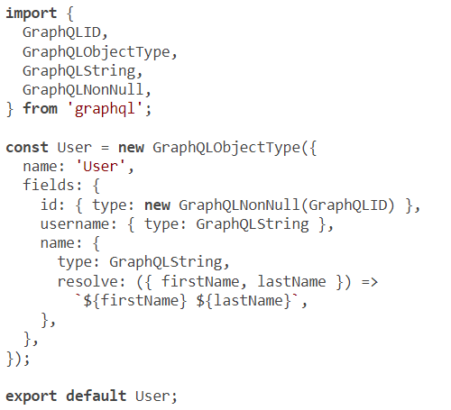
Resolving a one-to-one relation
Notes:
Here’s a possible implementation of the new User type along with its non-default resolver for the name field.
Note that for the resolve functions of the name field, I destructured the properties that are to be used in the resolver out of the first source argument.
NOTE
I did not include the createdAt field under this new type. I’ll add it when we implement the me root field. The timestamp when the user was created should not appear under the author relation. It can be helpful under the me root field. For example, a UI can use it to show profile information for the currently logged-in user.

Slide 43
Resolving a one-to-one relation
import User from './user';
const Task = new GraphQLObjectType({
name: 'Task',
fields: {
// ·-·-·
author: {
type: new GraphQLNonNull(User),
resolve: (source, args, { pgApi }) =>
pgApi.userInfo(source.userId),
},
},
});
Notes:
To use this new User type, we need to import it in the Task type and make the new author field use it. To resolve the author field, we just make a call to the userInfo function we added to pgApi.

Slide 44

Resolving a one-to-one relation
You can test the new relation with this query.
{
taskMainList {
content
author {
id
username
name
}
}
}

Slide 45
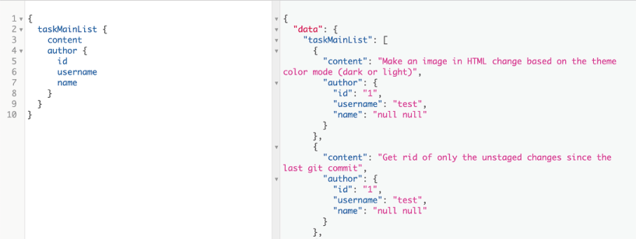
Resolving a one-to-one relation
Notes:
The API displays the information about the Author for each Task, which is the same test account in the sample data we’re using
There is a small problem in the data response in figure: the Author name was returned as null null. Why is that?
The null concept is confusing. Different coders associate different meanings with it. You need to be careful to always consider the possibility of dealing with null. You should ask, “What if this is null?” about every variable you use in your code. This is one reason why languages like TypeScript and Flow are popular: they can help detect these problems.
When we used the template string ${firstName} ${lastName}, we should have asked ourselves that question! What if these properties are null? JavaScript will just insert “null” as a string. How do we solve this issue?
First, do we need to have first_name and last_name as nullable columns in the database? Will there ever be a semantic difference between null and an empty string in these columns? If not (which is the most likely answer), it would have been a better design decision to make these fields non-null in the database and maybe make them default to an empty string.

Slide 46
Resolving a one-to-one relation
name: {
type: new GraphQLNonNull(GraphQLString),
resolve: ({ firstName, lastName }) =>
[firstName, lastName].filter(Boolean).join(' '),
},
Notes:
For the sake of example, let’s assume that we don’t have control over the structure of the database table and/or we cannot fix the data that’s already there. This does not mean we should leak these problems out to the consumers of this API. We can make the API’s name field non-null and make the server always return either the name or an empty string instead of nulls, or worse, nulls cast in a string.
There are many ways to implement that. Here’s one.

Slide 47
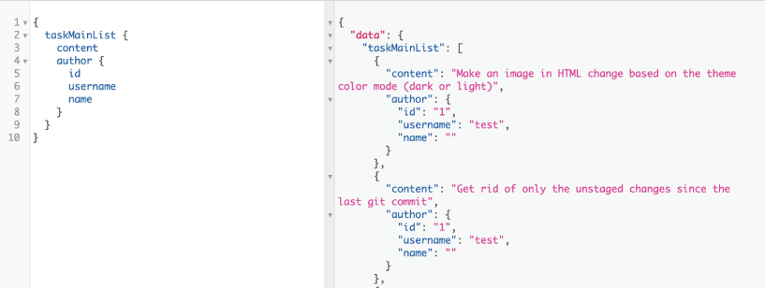
Resolving a one-to-one relation
Notes:
the API will always return a string that will ignore null values in firstName, lastName, or both
The N+1 queries problem
Now that we have implemented a relation and made the GraphQL server execute multiple SQL statements for it, we can talk about the N+1 queries problem. It is the first big challenge when implementing GraphQL services. To see this problem in action, you’ll need to enable logging for your PostgreSQL service and tail the logs while you execute GraphQL queries.
NOTE
How to enable logging for PostgreSQL depends on your platform, OS, version, and many other factors, so you’ll need to figure it out on your own. Make sure the server logs report a SQL query every time it is executed on the PostgreSQL service. The provided Docker image for PostgreSQL should do that out of the box.

Slide 48
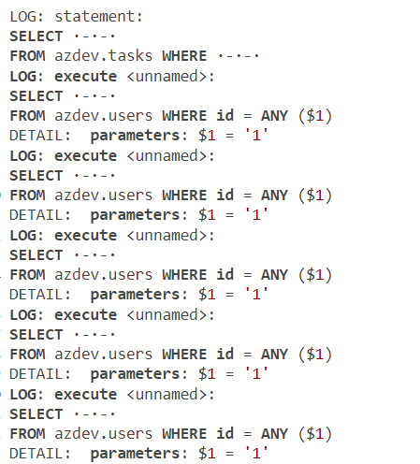
Resolving a one-to-one relation
Notes:
Once you’re tailing the logs, execute the query in listing 6.25 and find every instance in the log related to executing a SQL statement. Here are the SQL queries that were executed on my PostgreSQL server when I tested this.

Slide 49
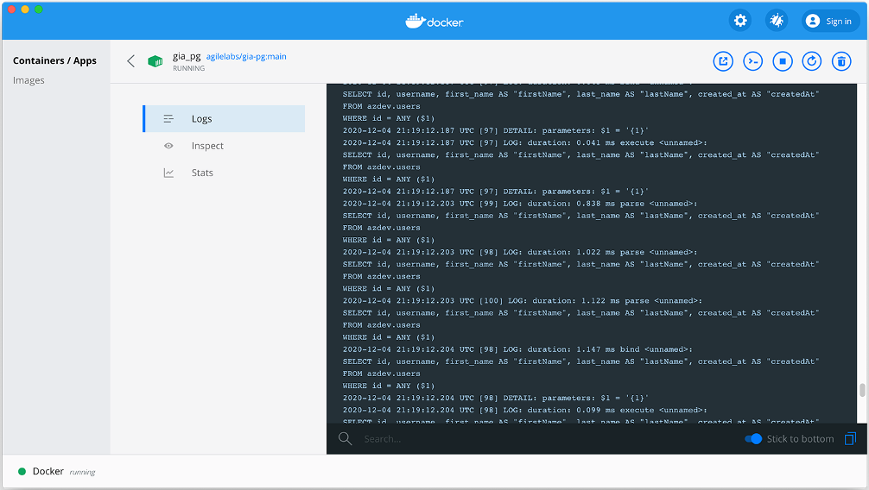
Resolving a one-to-one relation
Notes:
If you’re using Docker Desktop and the provided Docker images, you can see the PostgreSQL logs by opening the dashboard and navigating to the Logs view of the running gia_pg container (see figure). You can also see them in the output of the npm run start-dbs command.
TIP
PostgreSQL will likely log a lot more lines around these executions. For example, you might see parse/bind lines as well. Look for entries that have a statement or execute label.
Why are we executing six SQL queries? Because we have one main query (for Tasks), and we have five public Task records in the sample data. For each Task record, we’re asking the database about its associated User record. That’s five queries for Users plus the main query. This 5 + 1 is the N+1 problem. If we had 41 public Task objects in the azdev.tasks table, we would be executing 42 SQL queries here.
Clearly this is a problem. We should not be doing that. There are many ways to fix this issue. I’ll show you one of them here, and we will see a better one in the next lesson.

Slide 50

Resolving a one-to-one relation
const views = {
tasksAndUsers: `
SELECT t.*,
u.id AS "author_id",
u.username AS "author_username",
u.first_name AS "author_firstName",
u.last_name AS "author_lastName",
u.created_at AS "author_createdAt"
FROM azdev.tasks t
JOIN azdev.users u ON (t.user_id = u.id)
`,
};
// ·-·-·
Notes:
An easy way to fix this problem is through the direct use of database joins (or database views based on joins). Database joins are powerful. You can form a single SQL query that gets information from two or more tables at once. For example, if we’re to find a Task record and get the information for its associated User in the same SQL response, we can do a join like this (you can put this in api/src/db/sqls.js).
The tasksAndUsers string can act like a view, and we can use it to create an actual database view object if we want to. However, let’s just use it inline for this example.

Slide 51
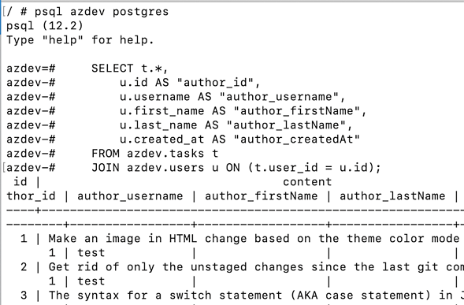
Resolving a one-to-one relation
Notes:
You can test the SELECT statement in a PostgreSQL client (like psql). Docker Desktop provides a CLI button to give you command-line access to the running container
Note that I used column aliases to prefix the users table columns with "author_". If we don’t do that, there might be a conflict in column names (for example, both tables have an id field). This prefixing will also make it easier for us to implement the GraphQL resolvers for this relation.

Slide 52
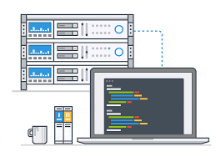
Resolving a one-to-one relation
taskMainList: `
SELECT id, content, tags, ·-·-·
"author_id", "author_username", "author_firstName",
"author_lastName", "author_createdAt"
FROM (${views.tasksAndUsers})
WHERE is_private = FALSE
ORDER BY created_at DESC
LIMIT 100
`,
Notes:
To use the tasksAndUsers view, instead of selecting from the azdev.tasks table for the sqls.tasksLatest SQL query, we can select from the new tasksAndUsers view.

Slide 53
// ·-·-·
import { extractPrefixedColumns } from '../../utils';
const Task = new GraphQLObjectType({
name: 'Task',
fields: {
// ·-·-·
author: {
type: new GraphQLNonNull(User),
resolve: prefixedObject =>
extractPrefixedColumns({ prefixedObject, prefix: 'author' }),
},
},
});
Resolving a one-to-one relation
Notes:
With that, the parent source object used to resolve the Task type will also have author_-prefixed columns that hold the author information inline in the same object. No further SQL queries are necessary. However, we need to extract the prefixed columns into an object suitable to be the parent source object for the User type resolvers. Let’s create a utility function to do that. I’ll name it extractPrefixedColumns. Here’s how we will use it in the Task type.

Slide 54
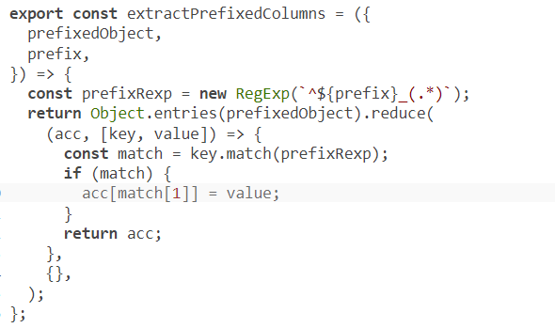
Resolving a one-to-one relation
Notes:
The implementation of extractPrefixedColumns can be a simple reduce call to filter the columns and only include the prefixed columns, but without their prefixes.

Slide 55
Resolving a one-to-one relation
LOG: statement:
SELECT ·-·-·
FROM (
SELECT ·-·-·
FROM azdev.tasks t
JOIN azdev.users u ON (t.user_id = u.id)
) tau WHERE ·-·-·
Notes:
That’s it! You can test the query in listing 6.30, and it will work exactly the same-except instead of N+1 executed statements in the logs, there will be exactly one statement.
This method is simple. It’s efficient in terms of communicating with PostgreSQL. However, it does mean that for each returned row, we need to perform a loop over its objects to extract the prefixed keys. This issue can be improved by changing the Author type to resolve directly with the prefixed values. However, that means adding more complexity, which, I think, will make the code less readable. There is a better way, and we will discuss it in the next lesson.
I am going to undo all the view-based changes made to solve the N+1 problem to prepare for the other solution. However, before we talk about it, let’s resolve the last remaining relation under taskMainList: the list of Approaches (and their Authors).

Slide 56
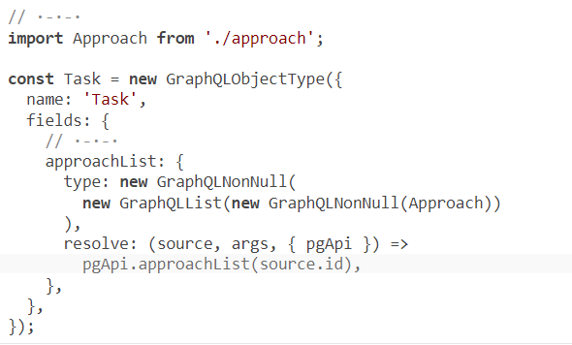
Resolving a one-to-many relation
Notes:
We’ll implement the approachList field starting from the types and resolvers. We need to modify the Task type to add the new approachList field. That field is a non-null list of non-null Approach objects (which is the new GraphQL type we need to introduce). To resolve the approachList field, we need a new function in pgApi that takes a taskId and returns an array of Approach objects associated with it. Let’s name that function approachList.
NOTE
This code uses two things that we do not have yet: the Approach type and the pgApi.approachList function.

Slide 57
Resolving a one-to-many relation
Let’s implement the Approach type next. This is the schema-language text we have for it.
type Approach implement SearchResultItem {
id: ID!
createdAt: String!
content: String!
voteCount: Int!
author: User!
task: Task!
detailList: [ApproachDetail!]!
}
Notes:
The implementation of this type is mostly similar to the Task type.

Slide 58
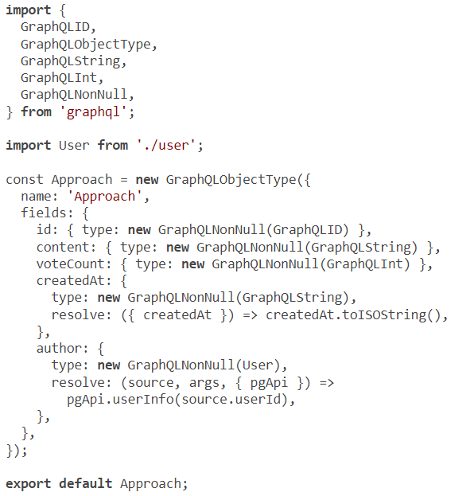
Resolving a one-to-many relation
Notes:
We can use the default resolvers for id and content, voteCount, the same ISO casting for createdAt, and the same code we used for the author field.
The approachList field must be resolved from the azdev.approaches table. The foreign key that connects a Task object to a list of Approach objects is the task_id field in the azdev.approaches table.

Slide 59
Resolving a one-to-many relation
tasksApproachLists: `
SELECT id, content, user_id AS "userId", task_id AS "taskId",
vote_count AS "voteCount", created_at AS "createdAt"
FROM azdev.approaches
WHERE task_id = ANY ($1)
ORDER BY vote_count DESC, created_at DESC
`,
Notes:
For each resolved Task object, we need to issue this SQL statement (which is already in the sqls.js file) to get the information about the list of Approach objects available under it.
TIP
Naming is hard, and I’m not always good at it. In the official open source repo for the AZdev API, you may see names other than the ones I use here in the course. In fact, if you can think of better names than those currently in the AZdev API GitHub repository, please open an issue or a pull request!

Slide 60
Resolving a one-to-many relation
const pgApiWrapper = async () => {
// ·-·-·
return {
// ·-·-·
approachList: async (taskId) => {
const pgResp = await pgQuery(sqls.approachesForTaskIds, {
$1: [taskId],
});
return pgResp.rows;
},
};
};
Notes:
The sqls.approachesForTaskIds statement will be used by the pgApi.approachList function that we will implement next.

Slide 61
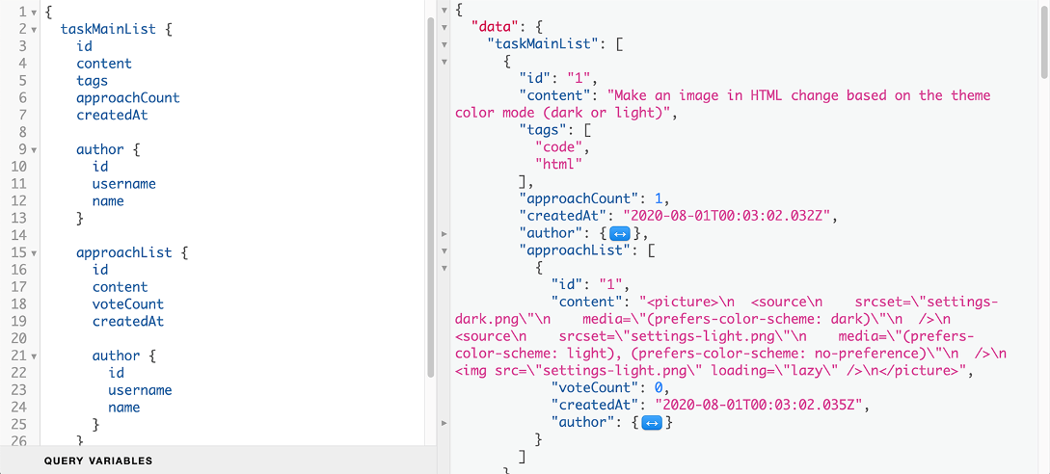
Resolving a one-to-many relation
Notes:
I hope this is getting easier for you. We still have a lot more examples to go through, but the taskMainList example is finally complete (figure)! Go ahead and test the full query for it from listing 6.24.
Guess how many SQL statements we’re sending to PostgreSQL to satisfy this GraphQL query?
One for the main Task list.
One for each Task’s Author info (five total).
One for each Task’s list of Approaches (five total).
One for each Approach on each Task to get that Approach’s Author info. We have a total of six Approaches in the sample data.
That’s a total of 17 SQL statements! We can still fix this with database views, but doing so will add a lot more complexity to the code. Let’s explore the better option, which is to use the data-loader concept. We’ll talk about that in the next lesson.

Slide 62
Summary
Use realistic, production-like data in development to make your manual tests relevant and useful.
You can use the GraphQL context object to make a pool of database connections available to all resolver functions.
Notes:
Start with the simplest implementations you can think of. Make things work, and then improve on your implementations.
You can use fields’ resolvers to transform the names and values of your data elements. The GraphQL API does not have to match the structure of the data in the database.
Try to separate the logic for database interactions from other logic in your resolvers.
It’s a good practice to wrap third-party APIs with your own calls. This gives you some control over their behavior and makes the code a bit more maintainable going forward.
Resolving database relations involves issuing SQL statements over many tables. This causes an N+1 queries problem by default because of the graph-resolving nature of GraphQL. We can solve this problem using database views, but that complicates the code in the GraphQL service. In the next lesson, we will learn about the DataLoader library, which offers a better way to deal with the N+1 problem and make your GraphQL service more efficient in general.

Slide 63

"Complete Lab"

